Slide 1


21 DAYS OF
MACHINE LEARNING
5/21
---Code Warriors---

Slide 2

Why Multiple Linear Regression
So far, we have seen the concept of simple linear regression where a single Independent variable X was used to model the Dependent variable Y .
But in many applications, there is more than one factor that influences the response.
e.g.,
Price of a house depends on multiple factors:
1. Location
2. Age
3. no.of rooms .,etc
---Code Warriors---

Slide 3
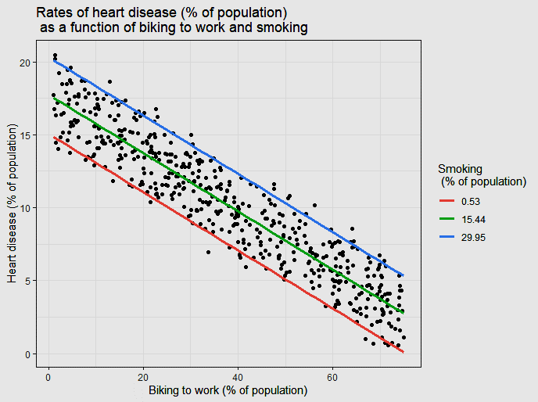
What is Multiple Linear Regression
Multiple regression model describe how a single Dependent variable Y depends linearly on a number of Independent variables X. It try to fit the model with multiple Independent Variables.
y = m1x1 + m2x2 + ... + mnxn + c
where c=c1+c2+...+cn
---Code Warriors---

Slide 4
Multiple Linear Regression
Advantage
Dis-Advantage
The ability to determine the relative influence of two or more Independent variables(X) to the Dependent variables(Y).
1. It'll fit the data with linear relation even if the data is not linearly distributed.
---Code Warriors---

Slide 5
Multiple Linear Regression Model
1
from sklearn.linear_model import LinearRegression
2
regressor=LinearRegression()
3
regressor.fit(X_train,y_train)
4
y_pred=regressor.predict(X_test)
---Code Warriors---

